Slide 1


RPA Essential Training Nanyang Polytechnic School of Information Technology

Slide 2

Conditions and Loops
What Is a condition?

Slide 3
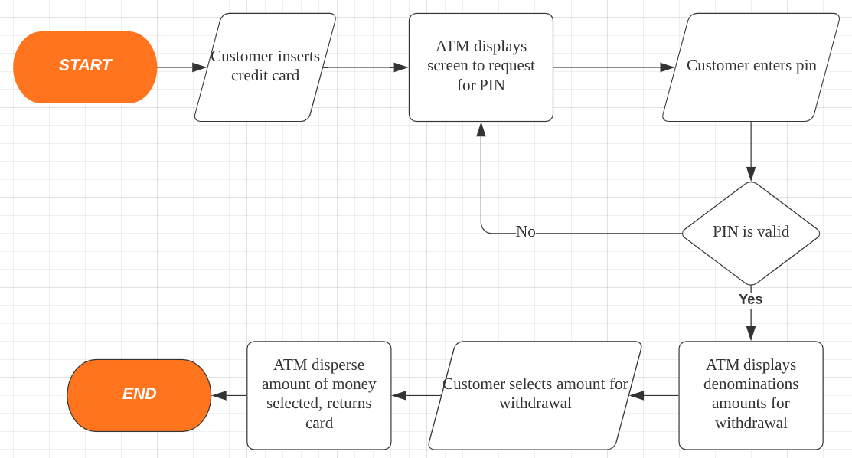
Decision making
If PIN is wrong?
If withdrawal limit is reached?
If customer choose to cancel?

Slide 4
A simple decision structure
condition
Cold outside
True
Cold outside
True
Wear a jacket
False
False
Wear a jacket
Wear gloves
Notes:
This example evaluate a cold weather condition. If the evaluation is false, you just walk out the house, If evaluation is true, u have to put on jacket before you leave the house.
Compare to the first case, the second case perform an additional action .

Slide 5
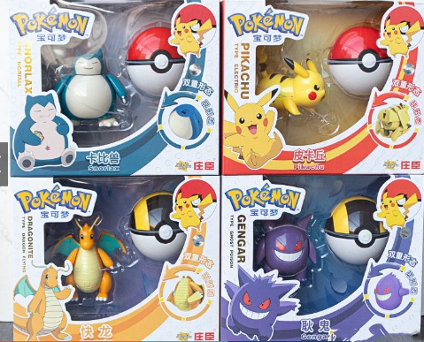
A Kid looking for a new Toy

Slide 6

What are the decision control structures she will use for finding a new toy?
IF Fun
IF NOT Fun

Slide 7
What are the decision control structures she will use for finding a new toy?
IF fun
ELSE
Print(“I want…”)
Print(“I don’t want…”)

Slide 8

What are the options? String Toy = “Pokemon”
IF toy is fun
ELSE
Print(“I want fun”+ Toy)
Print(“I don’t want…”+ Toy)
What if she is also looking for someone with money?

Slide 9
What are the options? Toy = “Pokemon”
ELSE IF
IF Toy is Fun
ELIF Toy looks Cool
ELSE
Print(“I don’t want…” + Toy)
Print(“I want Fun” + Toy)
Print(“I want Cool looking” + Toy)

Slide 10
What are the options? Toy = “Pokemon” ToyIsFun = True ToyLooksCool = True
ELSE IF
IF (ToyIsFun == True):
ELIF (ToyLooksCool == True):
ELSE
Print(“I want Fun” + Toy)
Print(“I don’t want…” + Toy)
Print(“I want cool looking” + Toy)

Slide 11
What are the options? Toy = “Pokemon” ToyIsFun = True ToyLooksCool = True ToyPrice = $10
ELSE IF
IF (ToyIsFun & ToyLooksCool== True):
ELIF (ToyPrice < 10):
ELSE
Print(“I don’t want…” + Toy)
Print(“I want fun & cool” + Toy + “that mum can afford”)
Print(“I want Fun & cool” + Toy)

Slide 12
The if Statement (one way decision)
sales > 5000
True
if sales > 5000 :
bonus = 500
commision_rate = 0.1
print(‘You met your sales quota!’)
bonus = 500
False
commission_rate = 0.1
print(‘You met your sales quota!’)
Calculate Pay
Notes:
Let’s follow the flow chart to construct the if statement
Assume this is a grab delivery men
If the sales is more than 5000 then program will execute additional 3 statement , firstly assign 500 to bonus and assign 0.1 to the commission rate and then print the meet quota message.
And then continue the next statement

Slide 13
The if-else Statement (two way decision)
start
age = input(‘Enter your age : ‘)
if int(age) < 18 :
print(‘you are too young to drive now’)
else :
print(‘you are of legal age to drive now’)
input(‘Enter your age’)
True
Age < 18
False
print(‘you are too young to drive now’)
print(‘you are of legal age to drive now’)
end
Notes:
The next one is to construct two way decision, based on one condition, you have two alternate set of statement to execute.

Slide 14
Conditions and Loops
What Is a condition?
Using a simple IF-ELSE

Slide 15

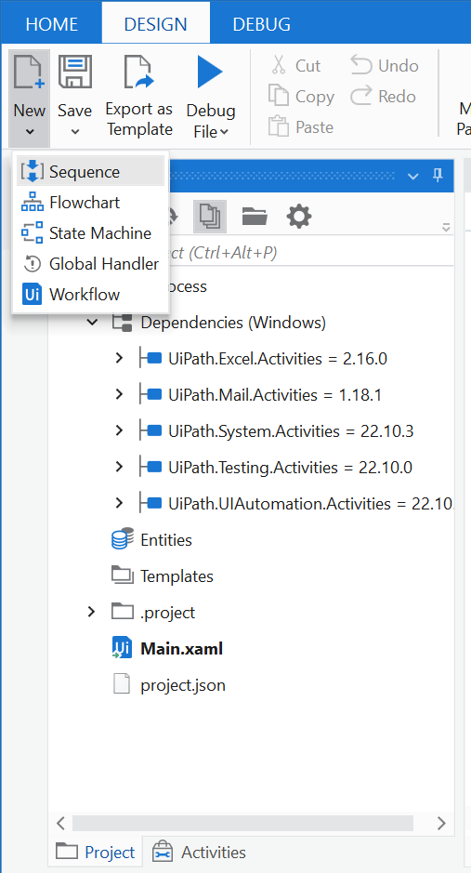
Instead of creating a new project, we an also add a new XAML file into an existing project instead.
Go to Design→ New → Sequence
start
input(‘Enter your age’)
True
Age < 18
False
print(‘you are too young to drive now’)
print(‘you are of legal age to drive now’)
end

Slide 16
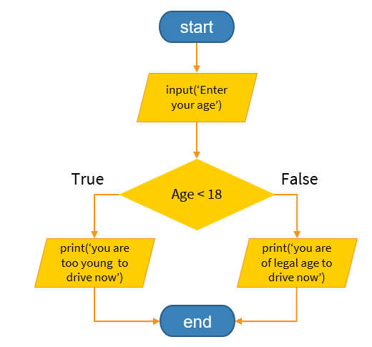
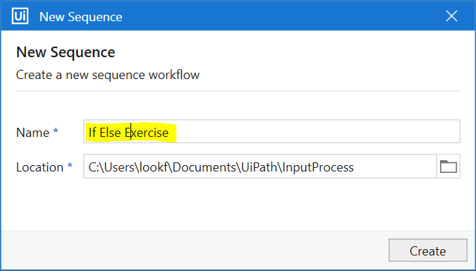
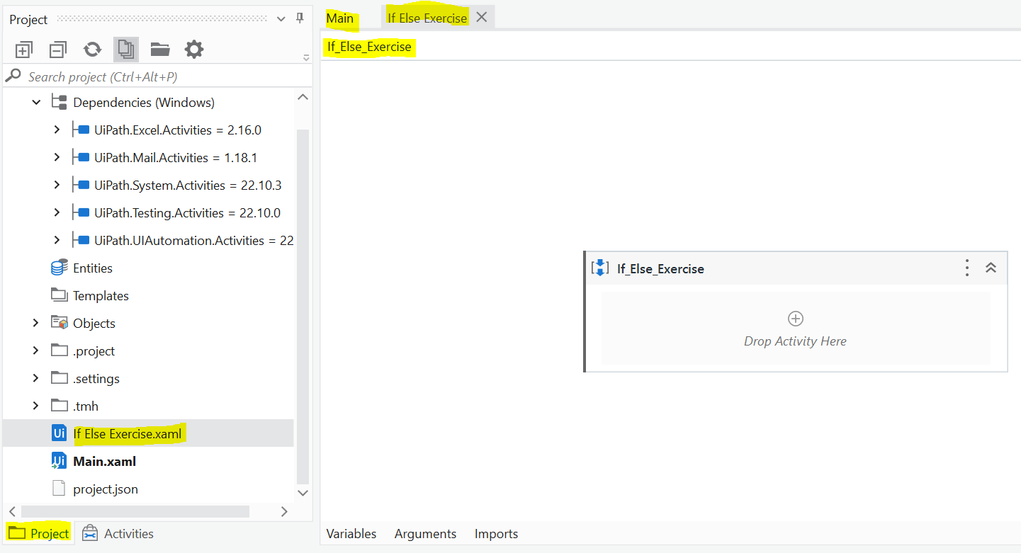
Enter If Else Exercise as sequence name
Notice that there are now multiple windows open for each file
Main.xaml
If Else Exercise.xaml
If Else Exercise .xaml file is created in project panel!

Slide 17
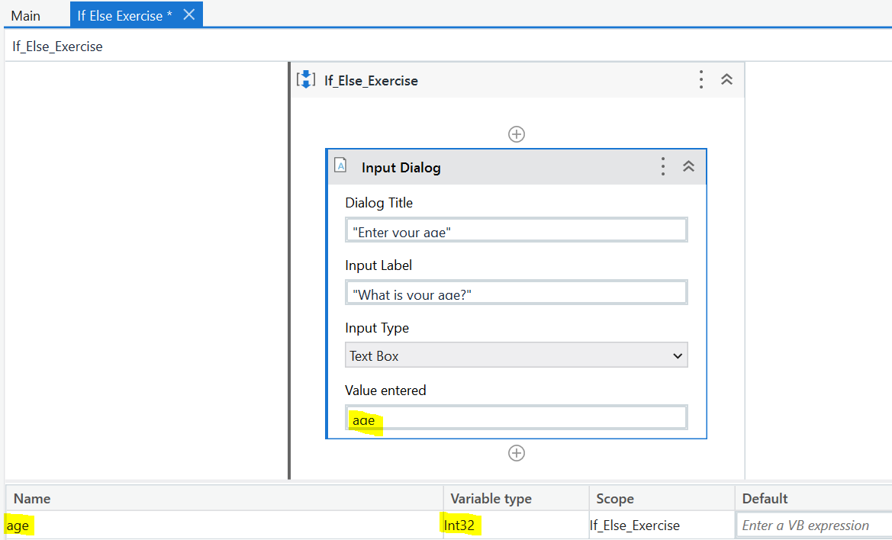
To get user input for age, add the Input Dialog activity again.
Try it yourself!
Title-> Type “Enter your age”
Input Label-> Type “What is your age?”
Input Type -> Choose Text Box
VERY IMPORTANT!
While you still create a variable to store user input, you will notice that the Variable Type must be updated to Int32. Int32 means a whole number.
This is because we will using Age as a number.

Slide 18
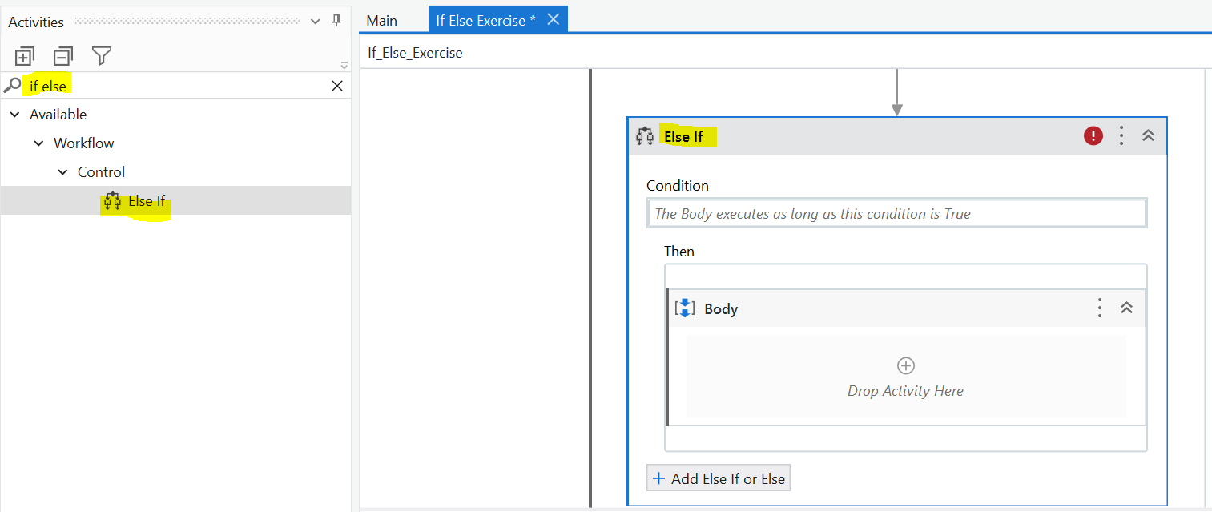
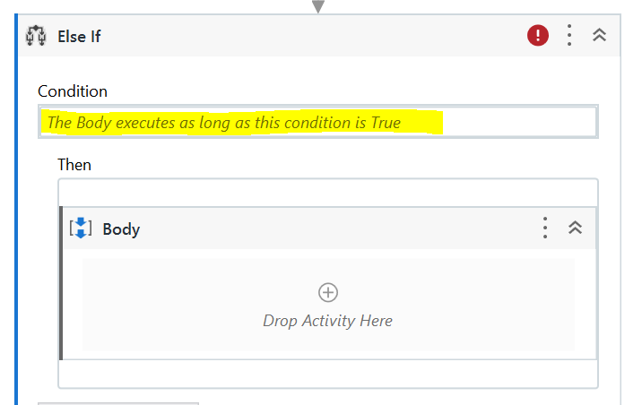
You will start to notice a pattern in the activity panel.
When you need any activity, just search relevant keywords (IF ELSE) and typically the activity will show up.
Add the IF-ELSE activity into the sequence
What should I put as condition?
→ If condition is TRUE, we will then go into the Body Sequence
As we know that age must be greater than 18, we can type in the condition as:
age >18

Slide 19
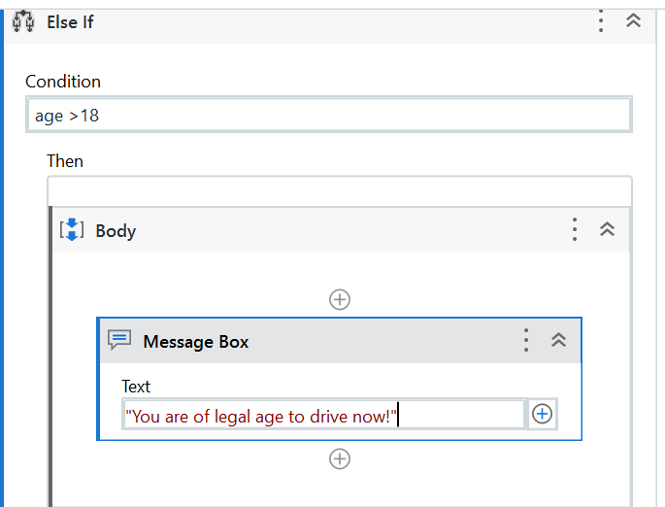
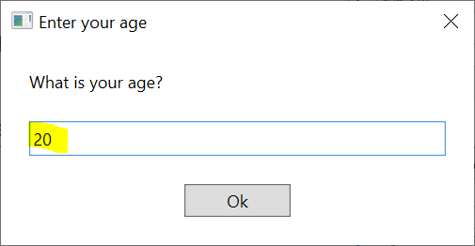
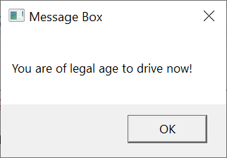
Add a Message Box Activity into the Body sequence of the Then section
Add the Text:
"You are of legal age to drive now!"
Test the program using Run File button.
(Run button will run Main.xaml instead as that’s the entry point of the project)
If you enter your age above 18,
the message box appears, else it will not.
Can we add another condition to check for 18 and below?

Slide 20
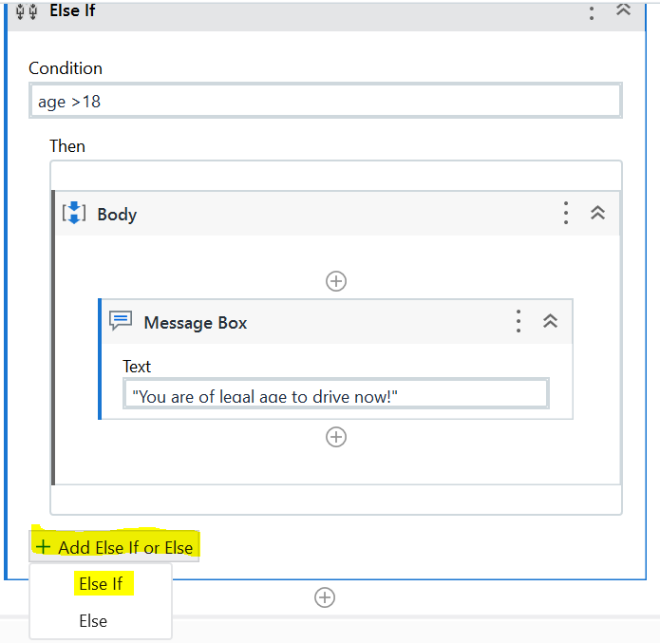
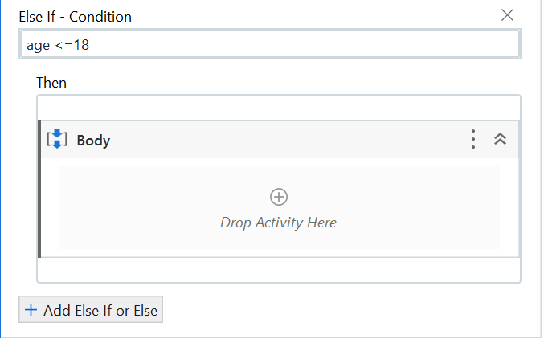
To add a new section for a new condition:
Click the Add Else If or Else → Else If
A new section will appear, and you can add in a second condtion.
What should I put as condition?
→ If condition is TRUE, we will then go into the Body Sequence
As we know that age must be lesser or equals to 18, we can type in the condition as:
age <= 18

Slide 21
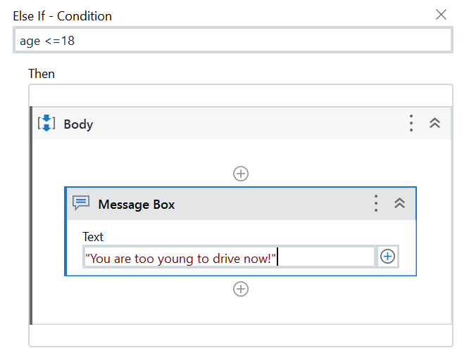
TRY IT YOURSELF!
Add in a message Box activity
Type in the text "You are too young to drive now!“
Click Run File totest out your program using above 18 and below 18 for age , and check the relevant messages.

Slide 22
Conditions and Loops
What Is a Loop?
Using a simple FOR EACH LOOP

Slide 23


Slide 24
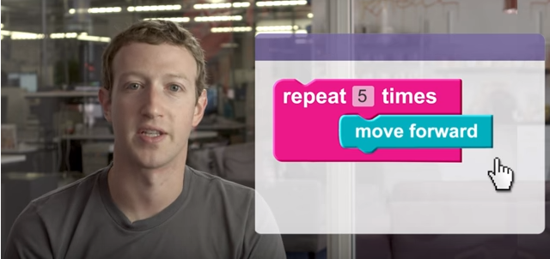


Slide 25
While will repeat until condition is not true
As long as condition is true, continue.
Potatoes = 9
While (potatoes > 6)
Potatoes
9
potatoes = potatoes - 1
8
7
This code keeps on repeating
6

Slide 26
Control Structures
Loop!
Using If-else can create branching paths for your solutions
If you move sequence backwards you also create a loop!

Slide 27
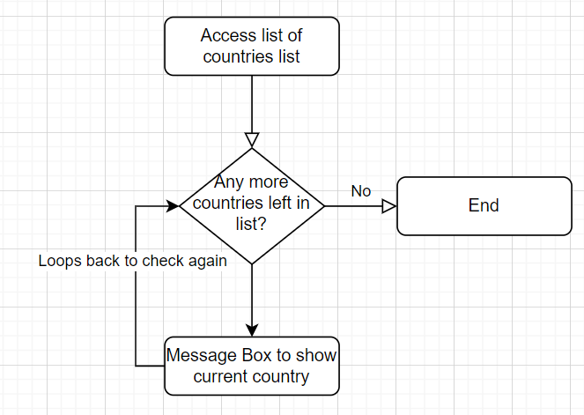
The purpose of Loops
Repeat actions based on conditions
2
Access list of emails
1
Loop is super important in UiPath
Processing rows of data
Manage rows in excel
4
3
Let’s create a simple robot that display a list of countries!
Notes:
Using RPA and its tools, an organization can easily configure a robot to analyze and interpret applications for processing. RPA helps in communicating with other IT systems. RPA enabled businesses have an edge in terms of speed of operations leading to better services for end-customers.
Let’s talk about some of the most popular processes where RPA is deployed in businesses today:
1. Payroll Processing: RPA authenticates the consistency of employee data across the organization. It validates the time records, bonuses, and deductions for new and existing employees. It can also automate paycheck calculations, employer benefits, and compensations.
2. Client Information Updates: With the rule-based and repetitive nature of client information updates activities, RPA can automatically generate a pre-structured workflow once the updates are available. Robots can also be configured to send out notification emails to new clients and the organization.
3. Accounting Reconciliation: Robots can easily extract data from various documentation sources such as bank statements or invoices. Software robots can also resolve purchase orders complexities which ensure orders compatibility and deliveries.
4. Invoice Processing: RPA can be used to process invoices. Be it on a paper or available electronically, the robots can automate the data inputs and even based on particular decision-making abilities it minimizes the need for human presence. The automated robots never lose track and make calculations to reduce errors. The overall process typically can be performed within a few minutes while the same task may require hours of human engagement.
5. Sales Order: Automated robots can perform operational sales activities, such as sales order entry, invoicing, etc. It can help in maintaining a sales database, thus improving the customer experience.
6. Compliance Reporting: RPA application helps in risk management and compliance reporting. It has the potential to help and support compliance components in a flexible manner. These robots help in cost and time management.

Slide 28
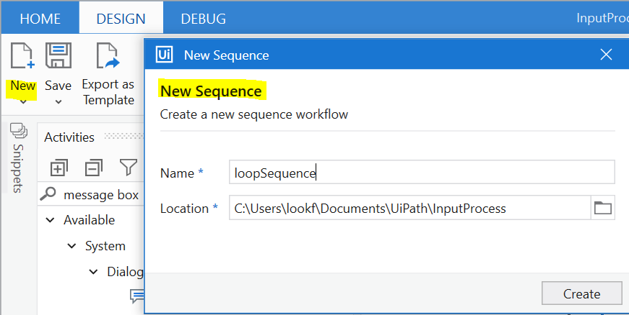
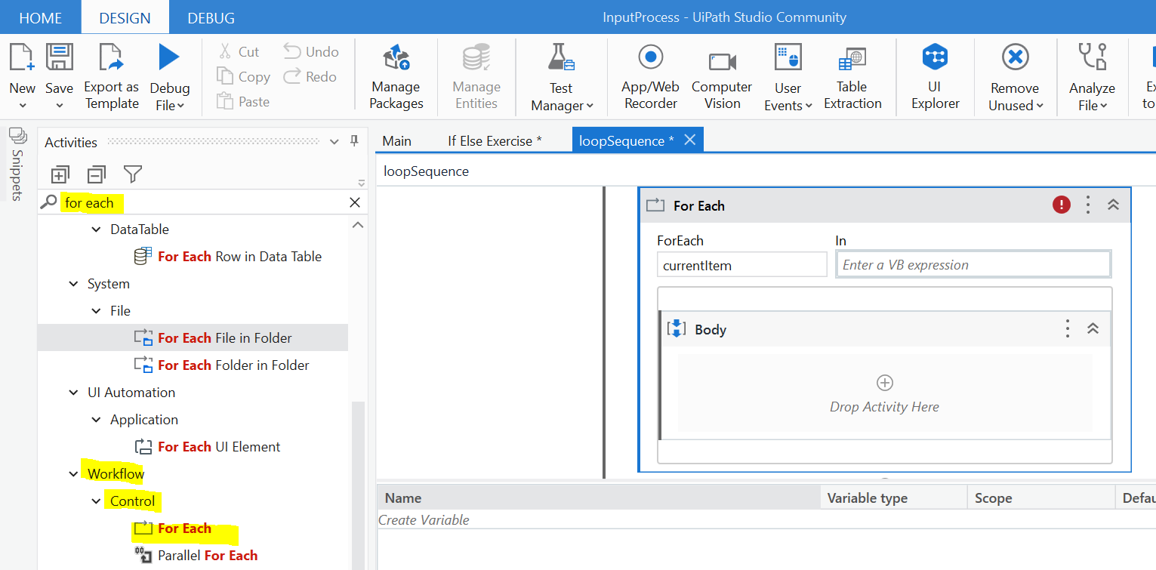
Creating a List looping robot that prints out countries
Try it yourself
Can you add a new sequence XAML file in the same project?
Design → New → Sequence
Type name as loopSequence
Try it yourself
Can you add a For Each activity into loopSequence?
Search for For Each in activity panel
Notice there are many type of loops to use.
Use the most basic For Each loop
Scroll down the list and drag:
Workflow→Control→ For Each

Slide 29
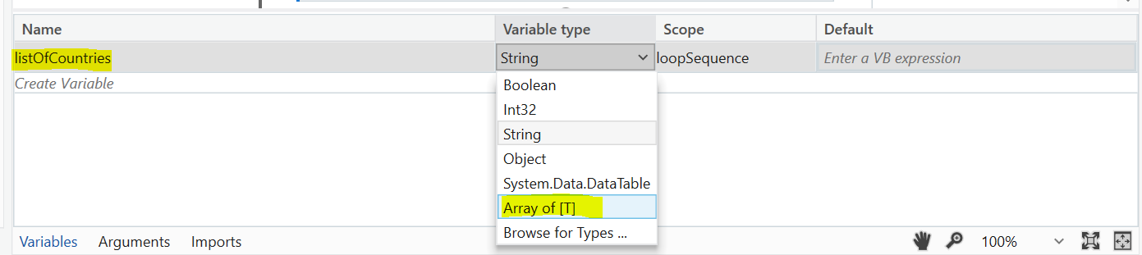
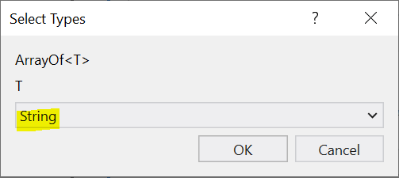
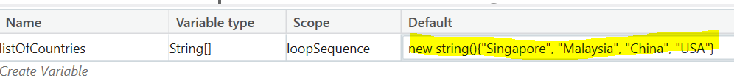
Creating a List of string
2) Type listOfCountries as variable name
4) Select String as variable type and click OK.
This means the Array contains String values.
1) Open Variables panel
3) Select Array of [T] as variable type.
Remember Array?
Definition
Usage
An array is a data structure that contains a group of elements of the same data type, such as an integer or string.
Used to organize data so that a related set of values can be easily sorted or searched.
To create the list of text string, type the following into the default value:
new string(){"Singapore", "Malaysia", "China", "USA"}
We have just created a list with 4 countries!

Slide 30
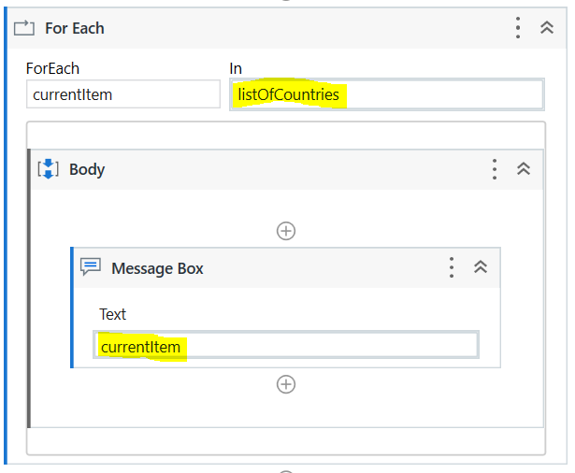
FOR EACH Country in the array, prints out the country
To print the countries, add the Message Box activity into the Body of For Each.
Try it yourself!
Add Message Box to Body of For Each
In → Add the listOfCountries variable so that it will loop the list.
Message Box Text→ Type currentItem
(currentItem refer to EACH item that you are extracting as the loop moves through the list)
Run File to test the Robot
The outcome will be that the robot will display a message box in order of each country in the list

